Slide 1
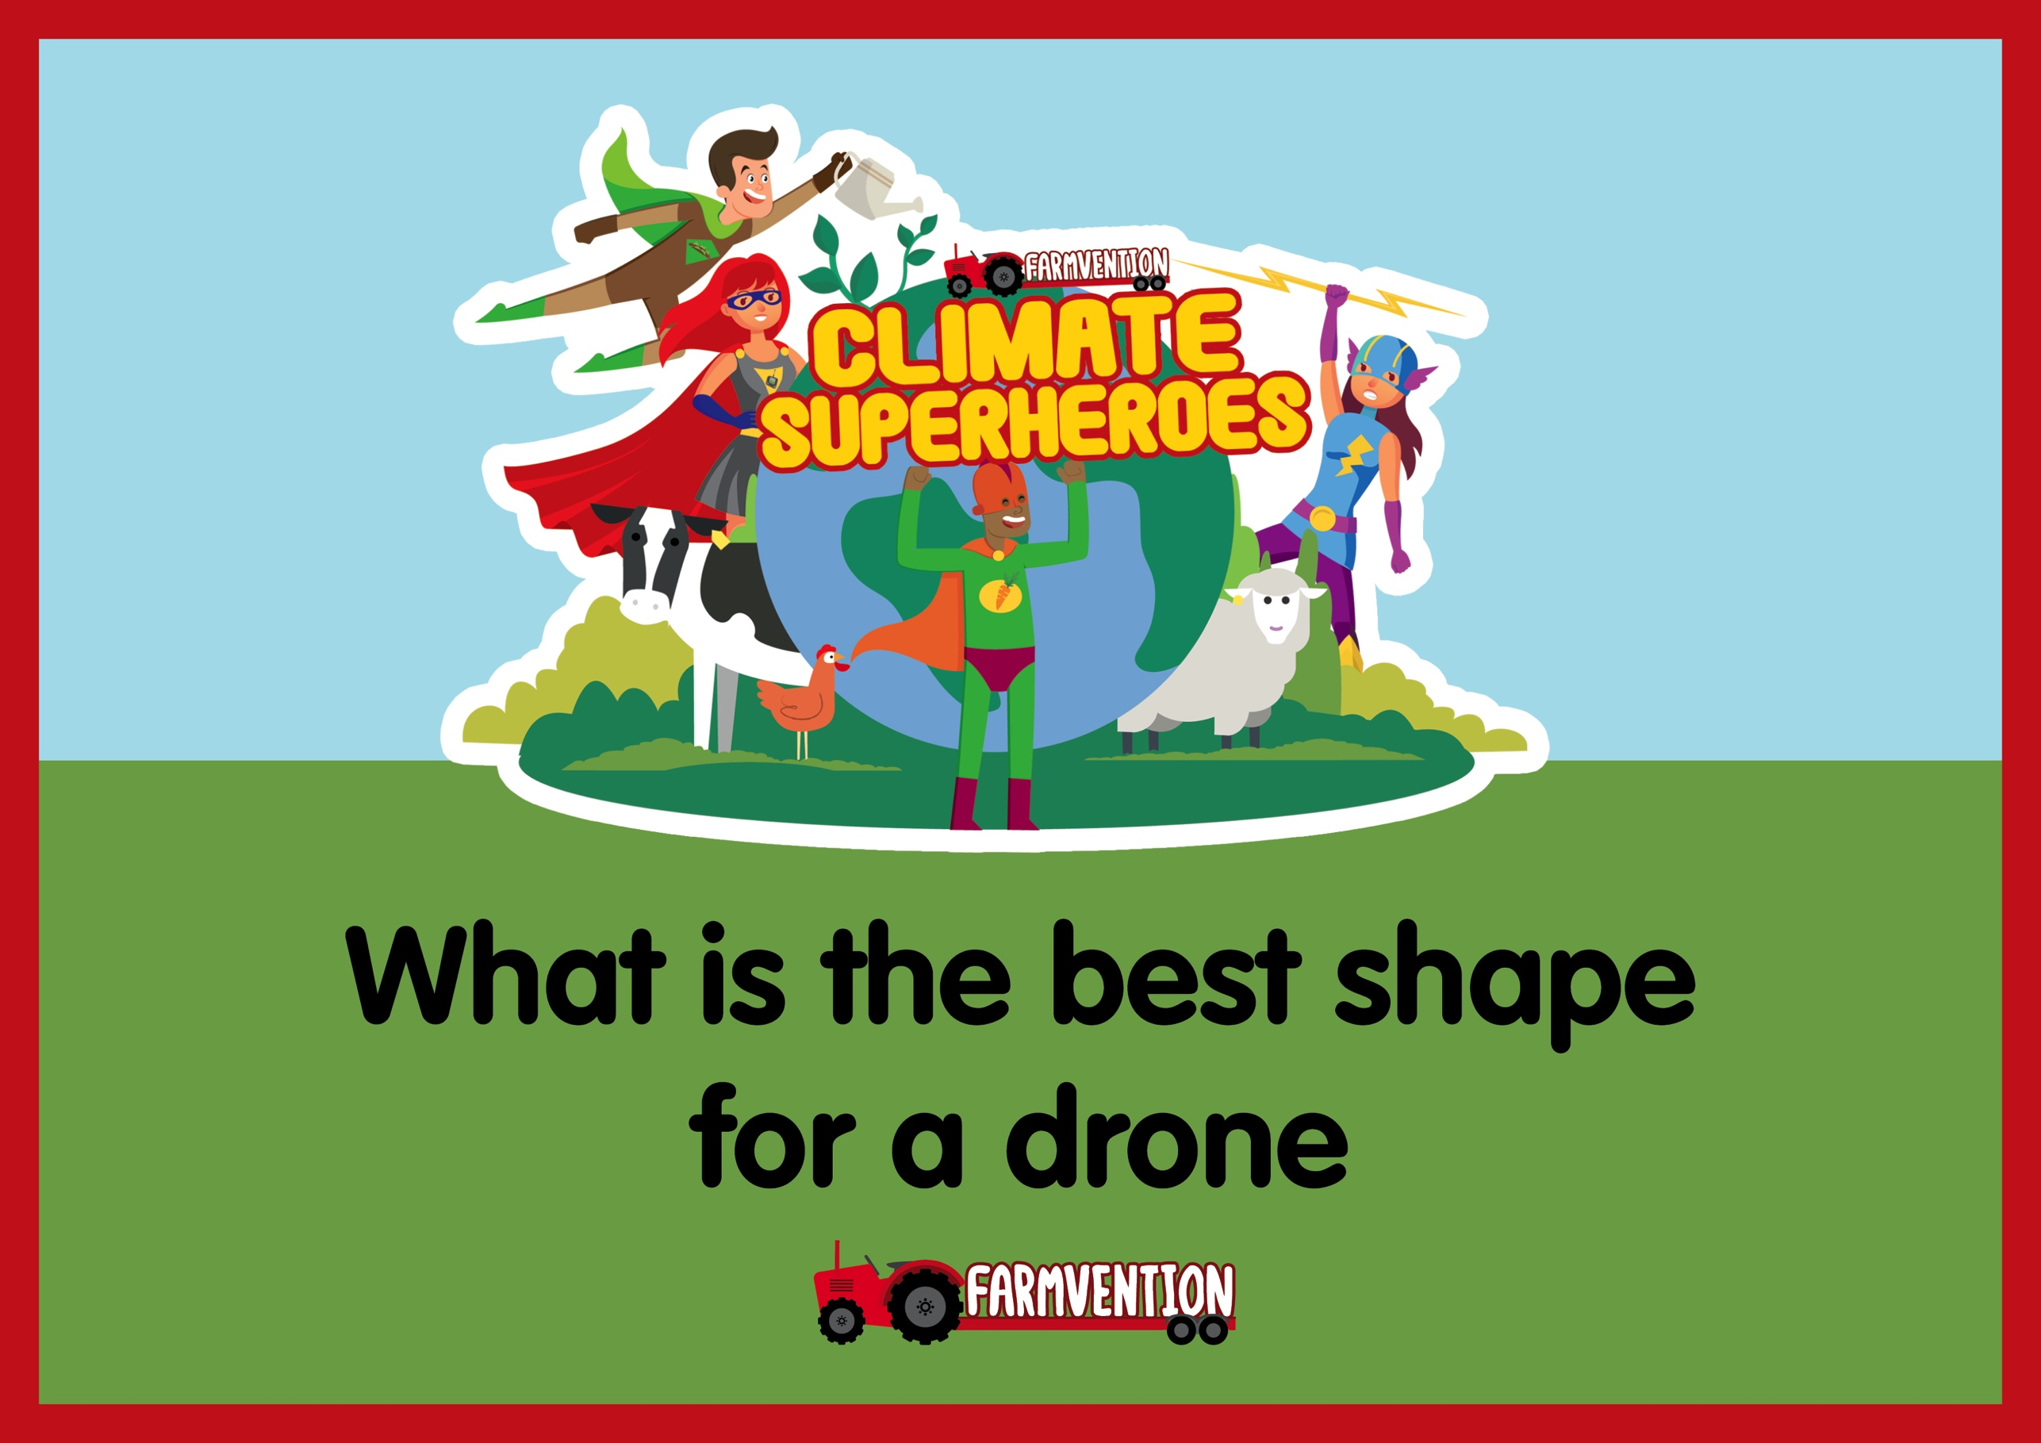

Slide 2
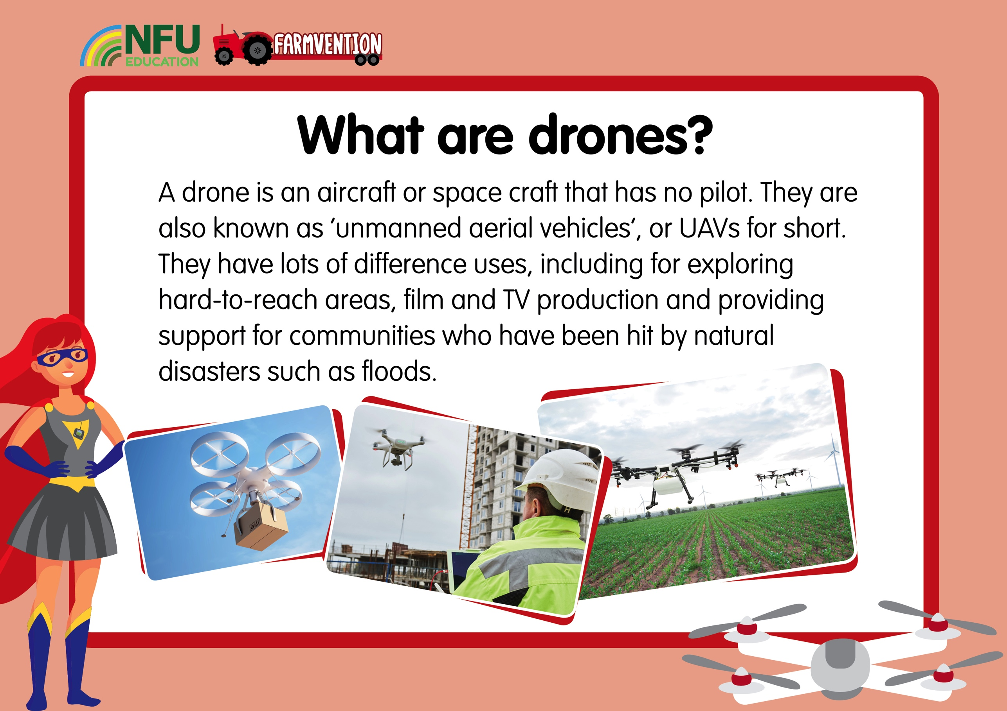
Notes:
Slide 2:
Drone technology is a relatively recent development and scientists are finding new creative uses for drones very day. They are useful because they can easily travel to places that it is difficult for humans to reach and gather lots of data (information) for scientists to analyse. They are also used to shoot creative scenes for films and television shows and many people use drones recreationally as a hobby.

Slide 3
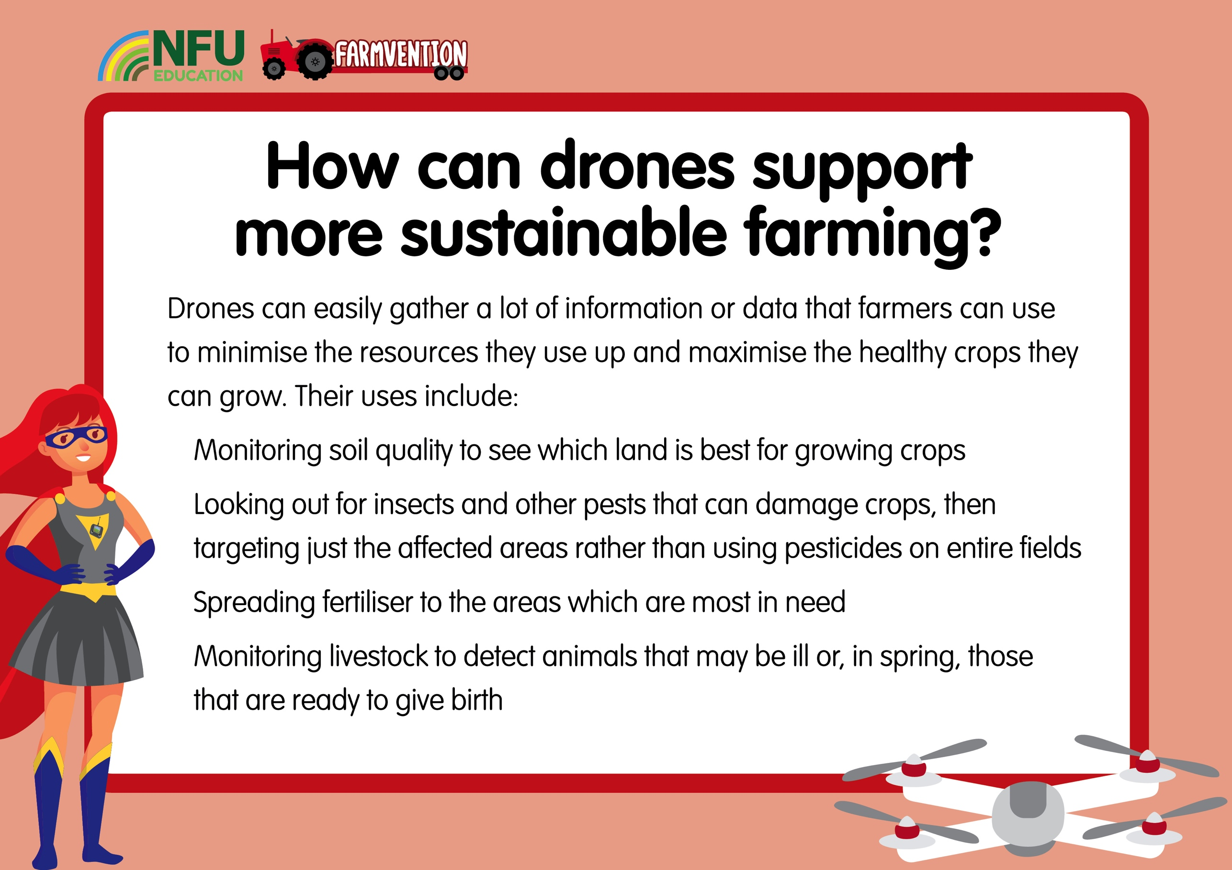
Notes:
Slide 3:
There are many different ways farmers can use drones to support more sustainable farming. These have potential to save time, money and resources and allow farmers to make the most out of their land.
Some uses include:
Mapping/surveying – drones with cameras and on-board computers can be used to survey large areas of land quickly and monitor plant health, soil quality and water supply. This means farmers can carefully plan for optimal land, water and fertiliser usage and prevent waste.
Crop dusting/spraying – Drones provide a safe way of spraying fertilisers and plant protection products that can be carefully targeted using the data that has been gathered, meaning no resources are wasted on areas that are not in need of them.
Livestock monitoring – Farmers can use drones with cameras to travel the long distances around fields and look out for animals that are missing, unwell or ready to give birth.
This video gives a quick look at some possible uses for drones on farms:
https://www.youtube.com/watch?v=i7GLo-2F7_o

Slide 4
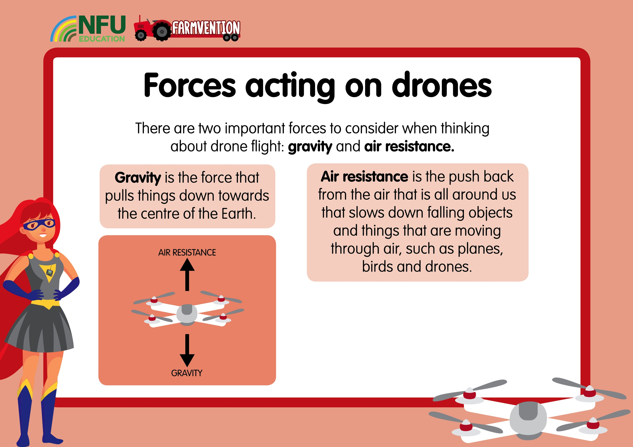
Notes:
Slide 4:
This video gives a good explanation of how gravity works on Earth:
https://www.youtube.com/watch?v=ljRlB6TuMOU
When drones are rising through the air, there is also a thrust force created by the propellers. If the upwards thrust force is greater than the force of gravity, the drone will move upwards, if the thrust force is equal to the force of gravity then the drone will hover in the air, and if the thrust force is less than the force of gravity then the drone will fall.
Air resistance is the push back from the gases in our atmosphere that slows down falling objects. This video explains how air resistance can affect the speed at which objects fall:
https://www.youtube.com/watch?v=dxcx35x5L9Y
Air is all around us, so air resistance doesn’t just exert a force on objects that are falling, but also objects moving in other directions, like drones which move up, down, forwards and backwards. To minimise the amount of air resistance working on a drone, engineers carefully design their shapes.
Questions to pose children:
Can you think of examples of these forces acting in everyday life? (Examples include a drink falling to the floor when a cup is tipped up, leaves falling from trees in autumn, a flat piece of paper falling to the floor slowly)
How do you think these forces affect drones?
How do drones overcome the force of gravity and rise up?

Slide 5
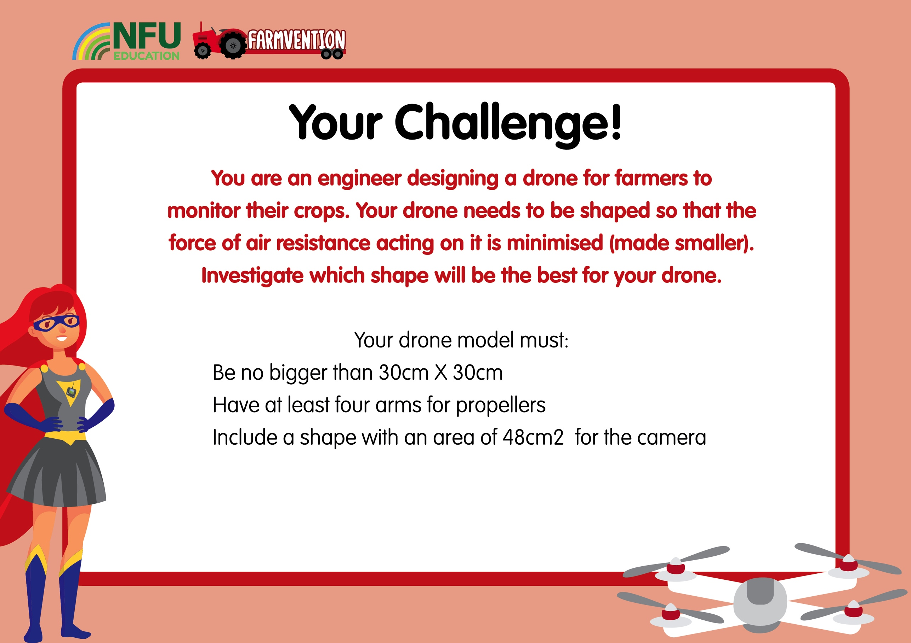
Notes:
Slide 5:
Set the challenge and discuss ideas for investigating the best shape to minimise the force from air resistance.
Questions to ask:
What material should we use to make our models?
How can we test how much air resistance there is acting on the models when they move?
How will we make sure our investigation is a fair test?
What shapes do you predict will be the best?
Do you think a symmetrical shape will be better or worse?
Do you think all the arms should be the same shape or same length?
Children may need help to plan their investigation and identify and control variables that could affect their results.
One possible suggestion for carrying out the investigation is to first draw and cut out a number of different possible shapes on thin card (this is a great way to re-use cereal box card or other similar packaging). Then, drop each one from the same height and time how long it takes to hit the ground. Slow-motion cameras on smartphones or tablets are very useful for observing things that happen very quickly.
You might want to carry out some research into the common shapes used for drones to base your ideas on. Internet image searches will bring up lots of inspiration!
Children can choose how they would like to shape the 48cm² - this could be a 6 X 8cm rectangle, a 4 X 12cm rectangle, an irregular shape, or any other configuration they would like. To make the task less challenging for younger children, you could cut out a 48cm² rectangle shape for them to use as a template when drawing their models.
Health and Safety: Supervise children when using scissors. Ensure they children do not put themselves in danger by climbing to high-up places to drop their drone models.

Slide 6
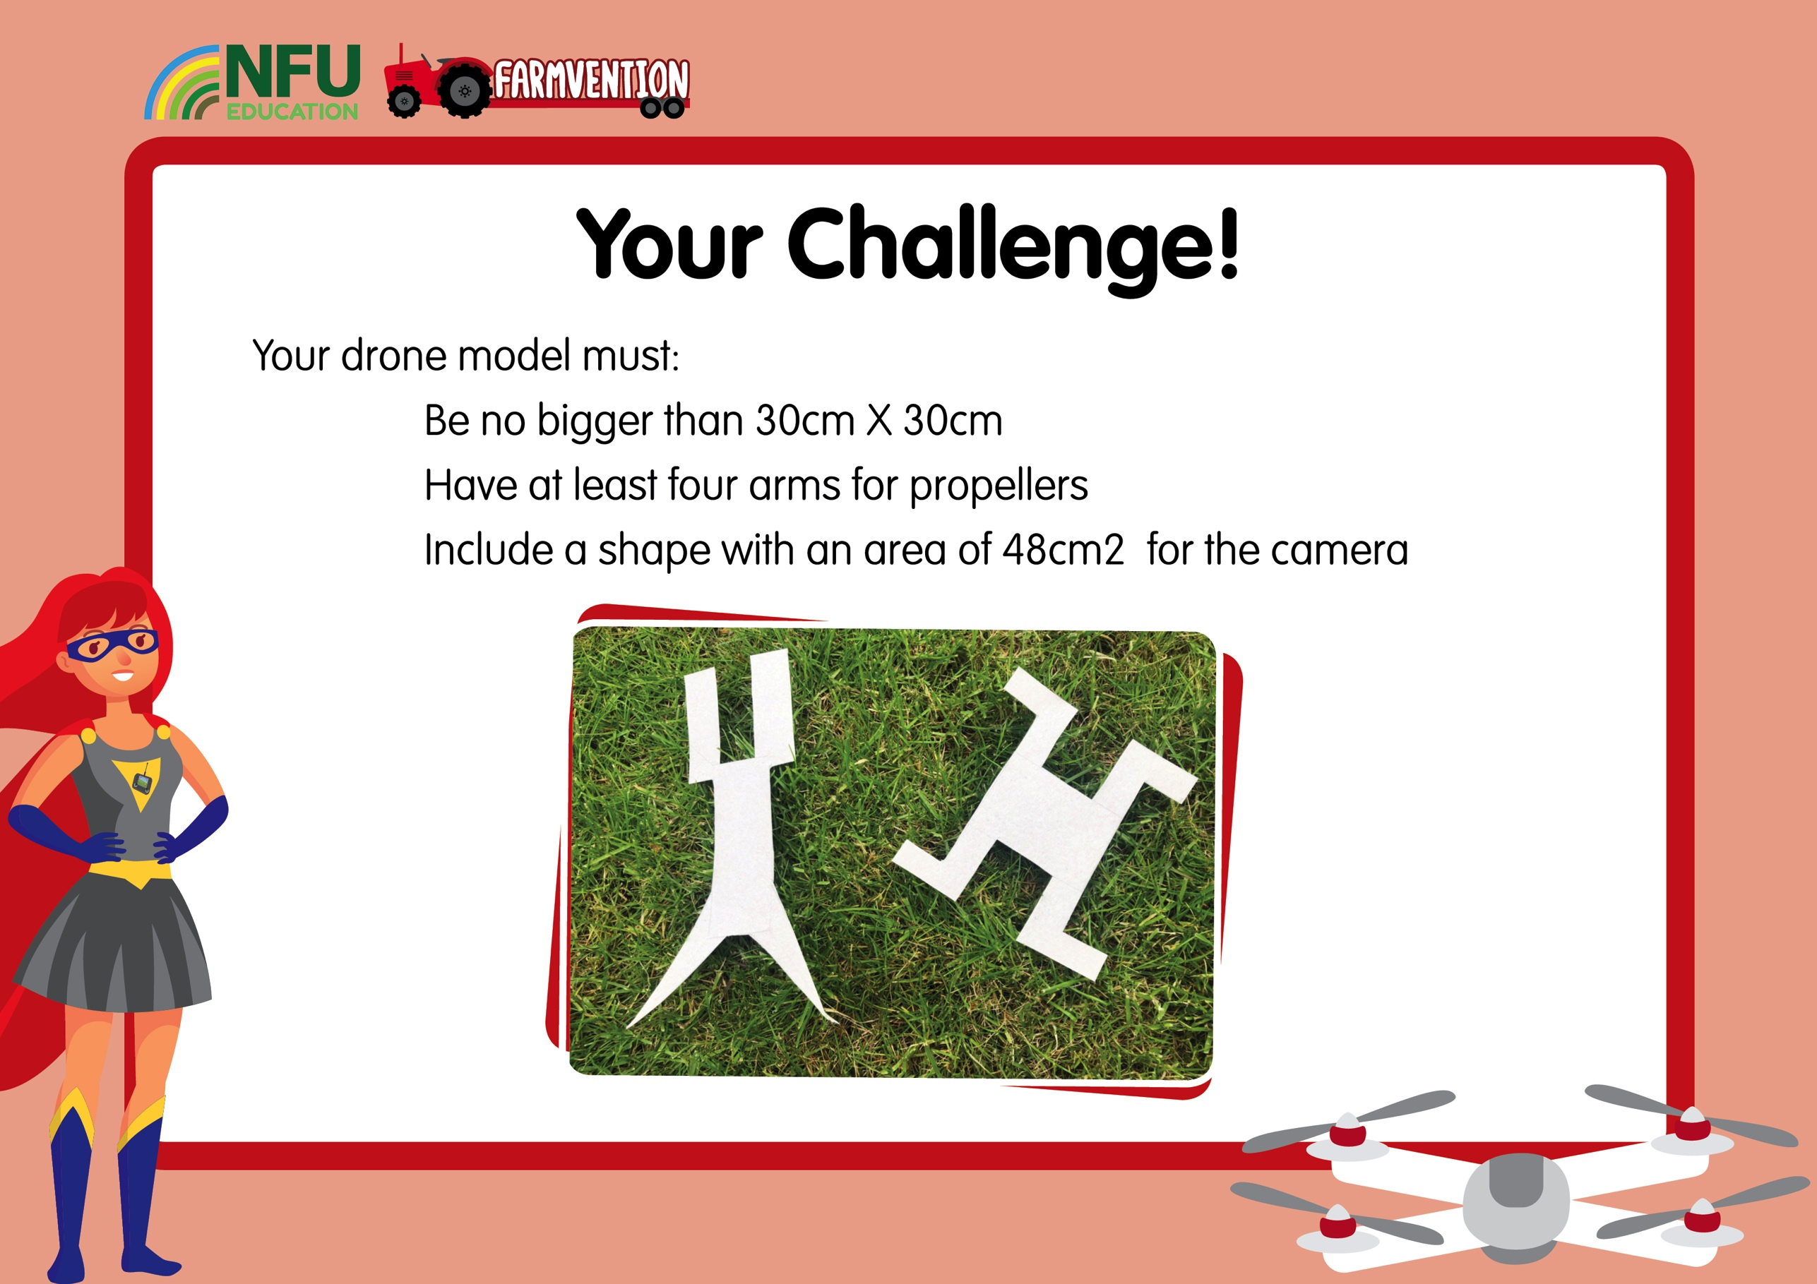
Notes:
Slide 6:
Here are some possible ideas for drone shapes made out of cereal box cardboard. You may wish to wait and see how children begin designing their drone shapes before showing them these examples or, if they are finding it difficult to come up with ideas it might be better to show these pictures early on.

Slide 7
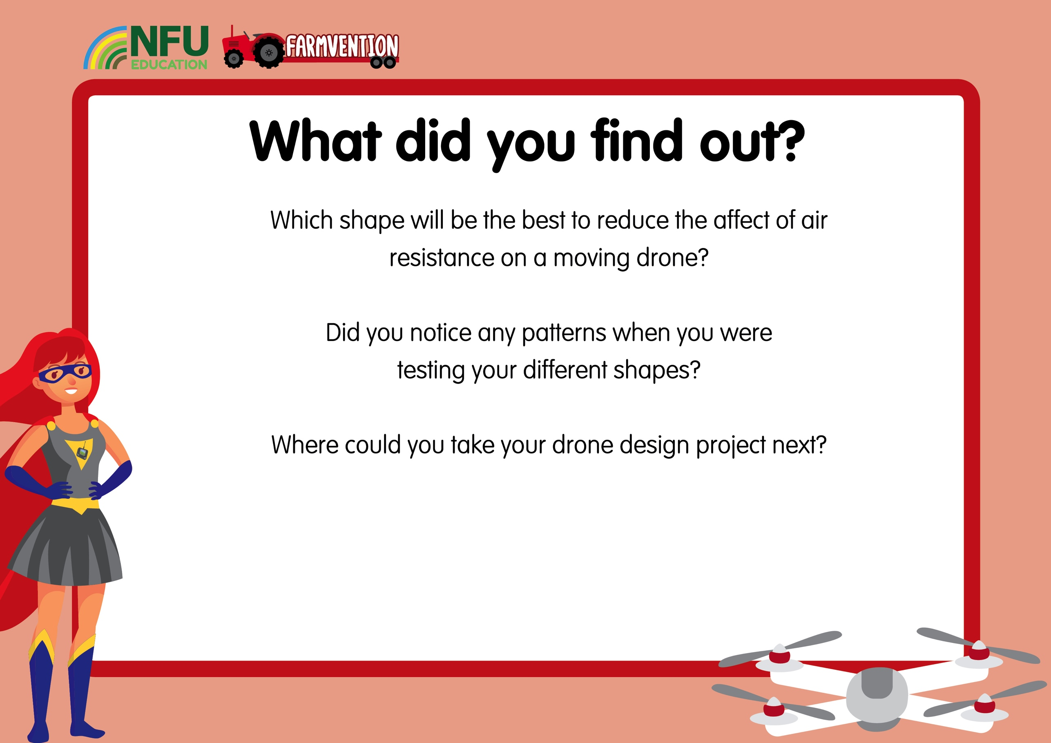
Notes:
Slide 7:
Children could use junk-modelling materials to create a better model of their drone or draw a labelled sketch, thinking about how it will look and have visual appeal. They could think about how they would market their drone to farmers and design advertising. They could do some more research about how drones work and what materials they are made out of.

Slide 8
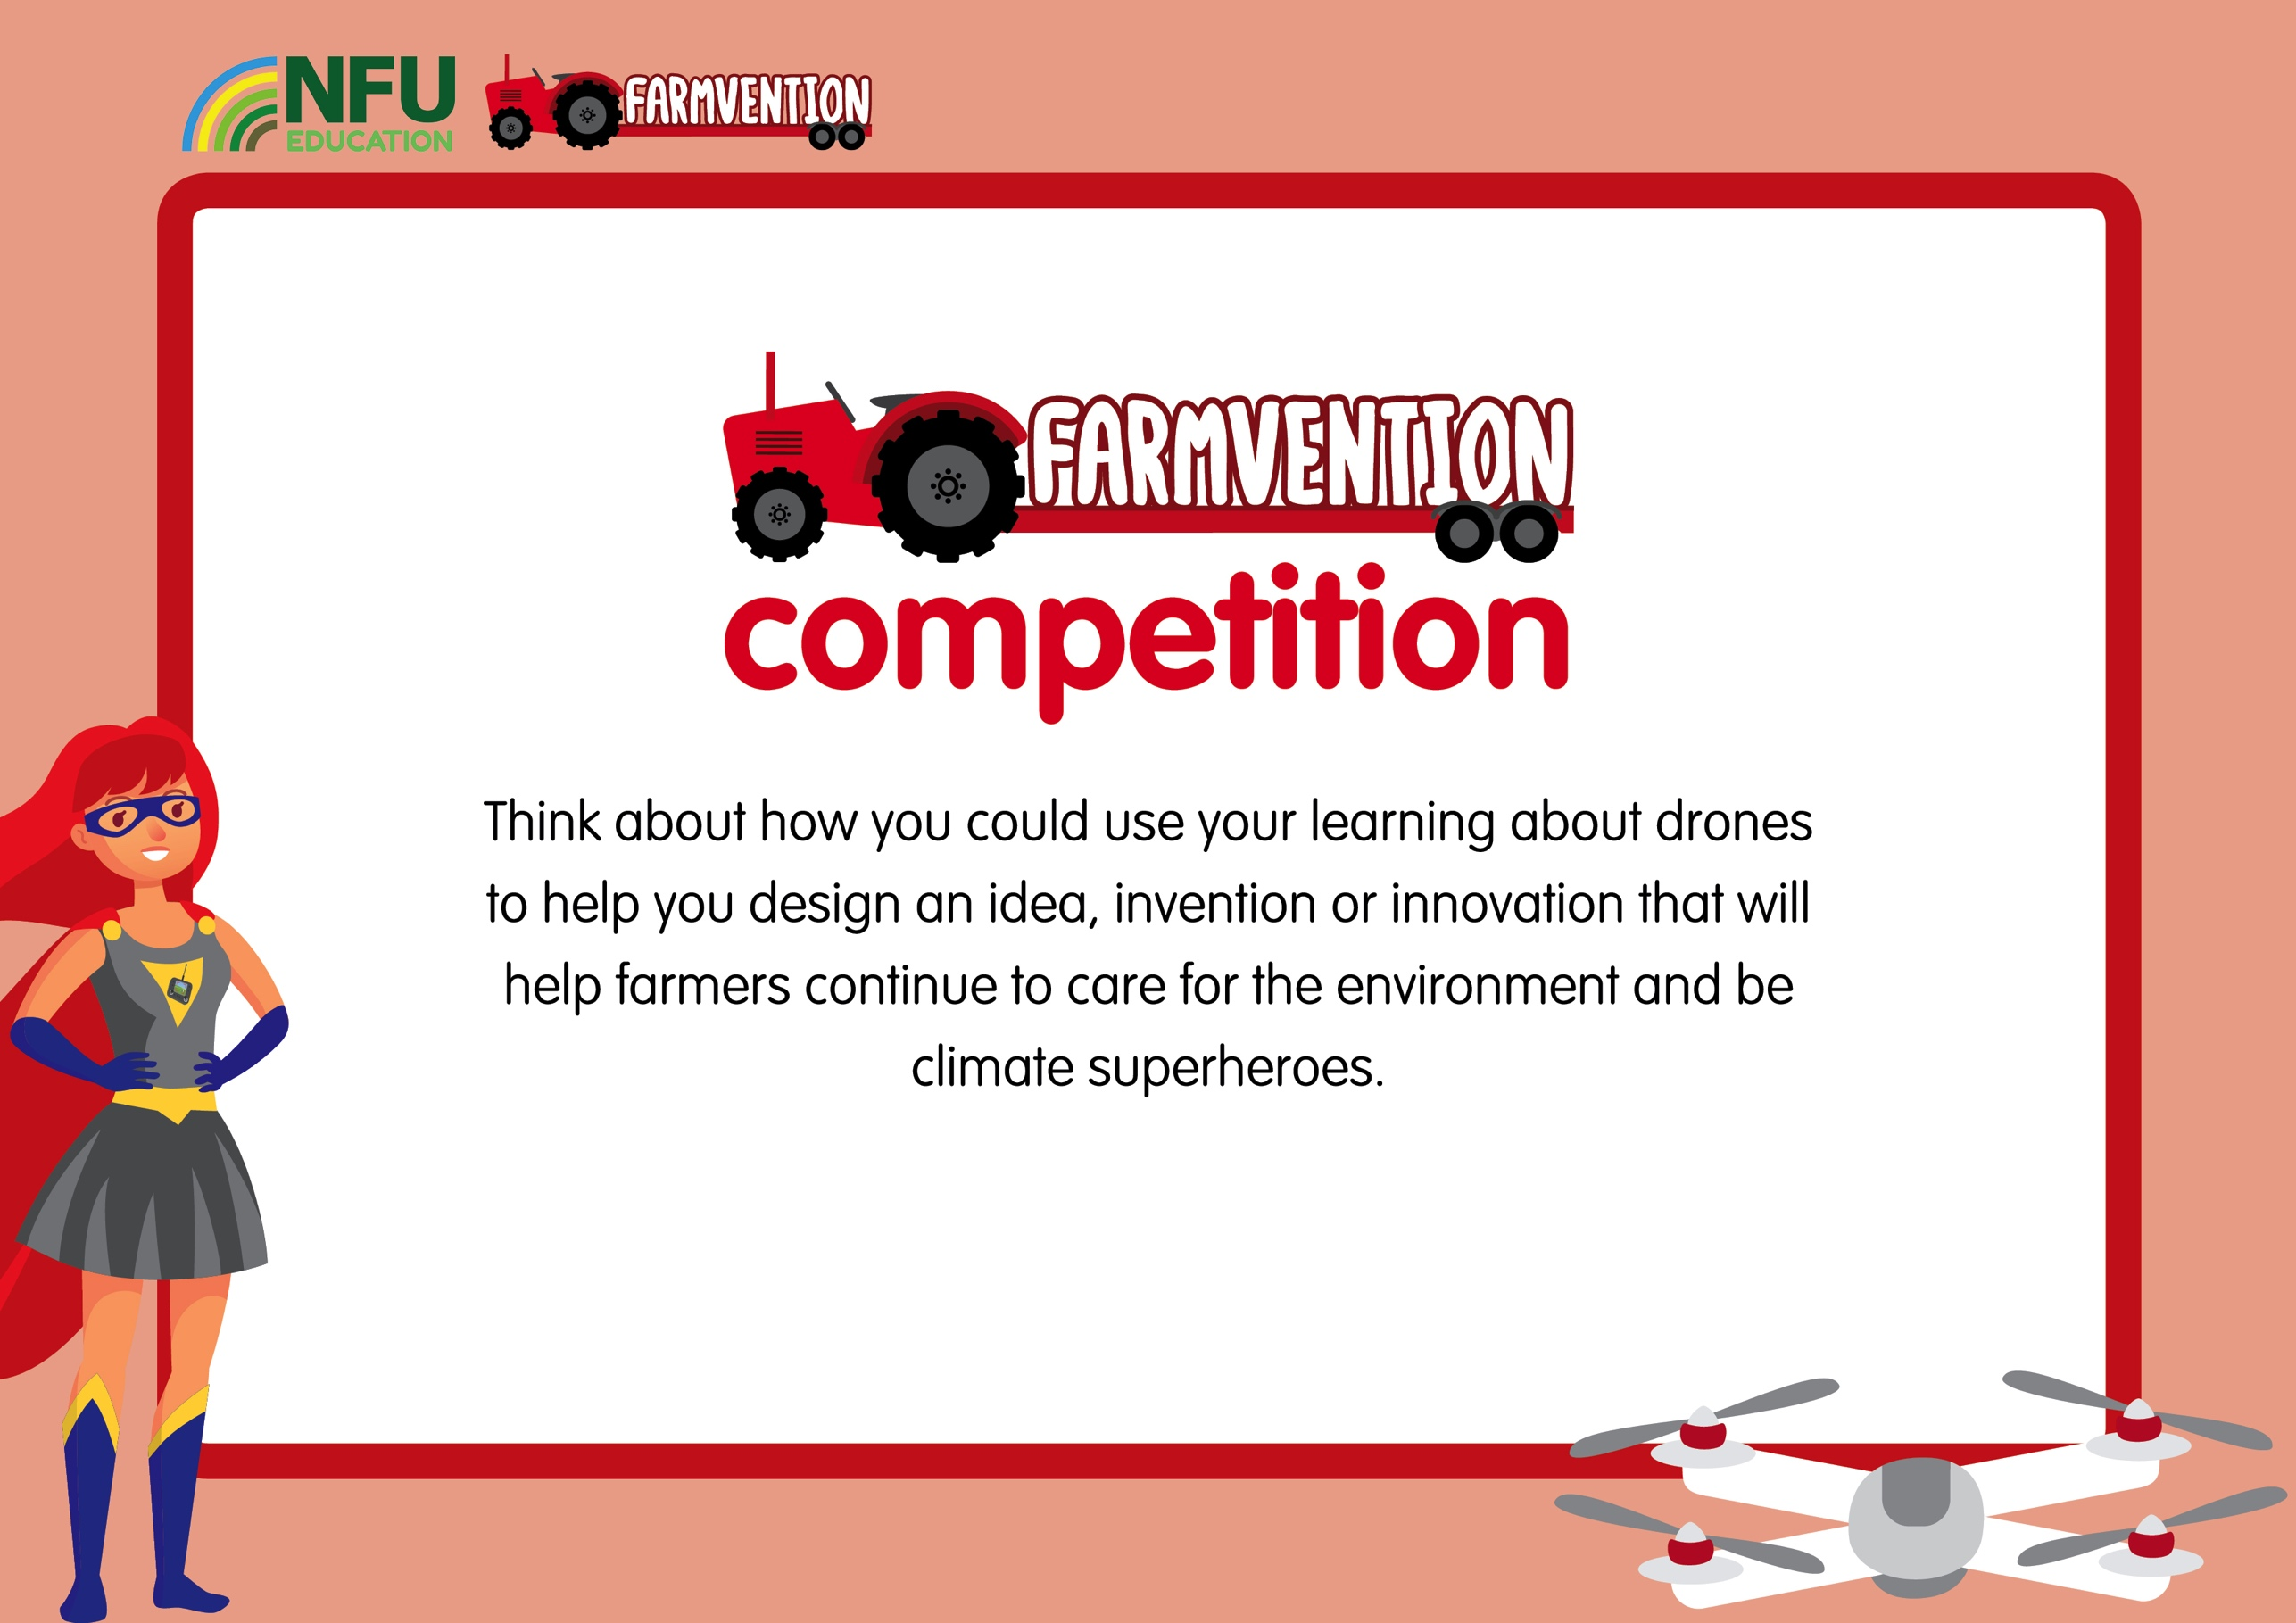
www.farmvention.com

